Slide 1


Item-based and User-based Movie Recommendation
using MapReduce and Hadoop
Team members: Boyang Qu, Ruixi Li, Tianxin Zheng, Haowen Shang
Advisor: Dr. Matthew Wachs
CMSC 12300
Notes:
‹#›

Slide 2

Hypothesis
Construct a recommendation system
Implement two algorithms
Item-based recommendation
User-based recommendation
Check accuracy
Split into training and testing sets
Cross validation
Calculate accuracy score
Make accurate movie recommendations!
Ruixi Li (MACSS, University of Chicago)
Notes:
‹#›

Slide 3
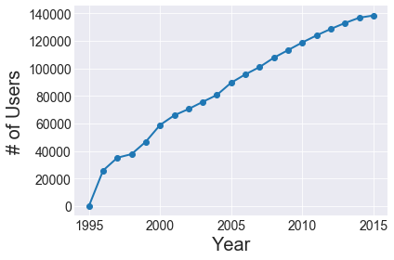
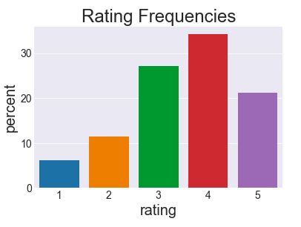
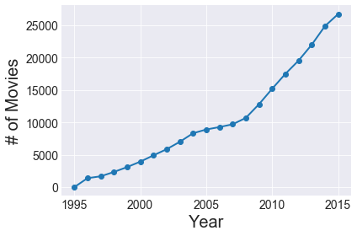
Dataset
27,753,444 ratings from 283,228 users on 58,098 movies
Boyang Qu (MACSS, University of Chicago)

Slide 4
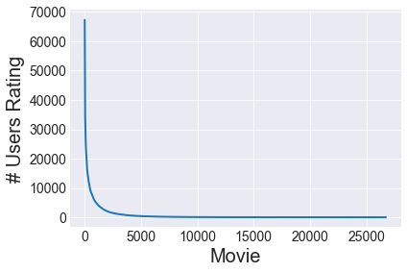
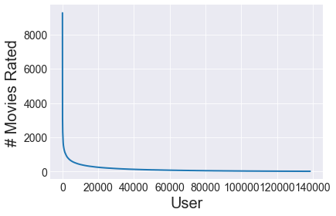
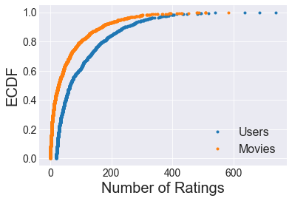
Dataset
40% of all users rated 50 or less movies, and 90% of movies have 169 or less ratings.
Boyang Qu (MACSS, University of Chicago)

Slide 5
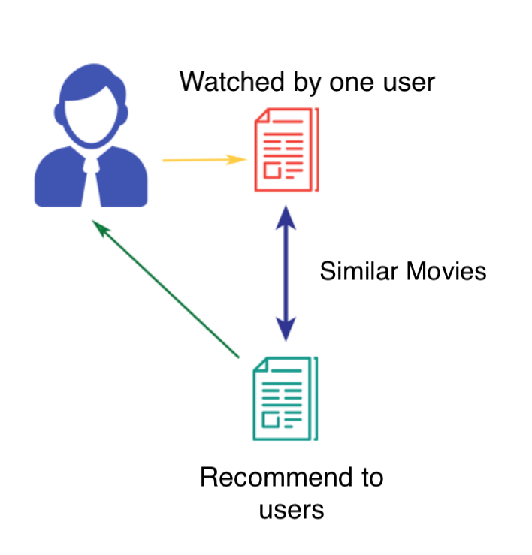
Algorithms
Item-based: Overview
extract user and (movie, rating) pair
get every pair of movies watched by same person and its corresponding rating pair
calculate similarity and make recommendation
Haowen Shang (MACSS, University of Chicago)
Notes:
‹#›

Slide 6
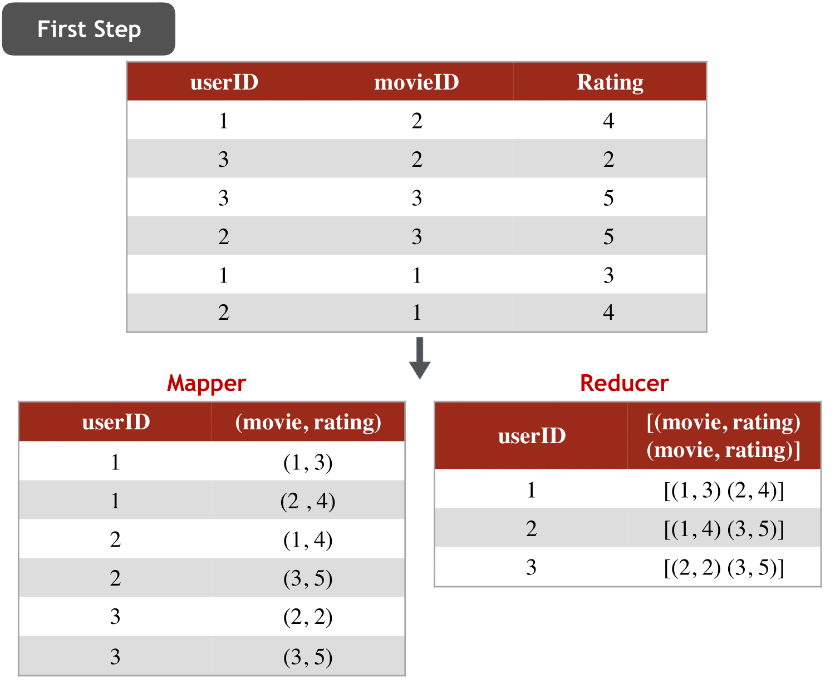
Algorithms
Item-based: 3-step MapReduce
Firstly, we want to find all movies and their ratings watched by each person. We will use a mapper to extract user and (movie, rating) pair and use a reducer to group all (movie, rating) pair by user.
Haowen Shang (MACSS, University of Chicago)
Notes:
‹#›

Slide 7
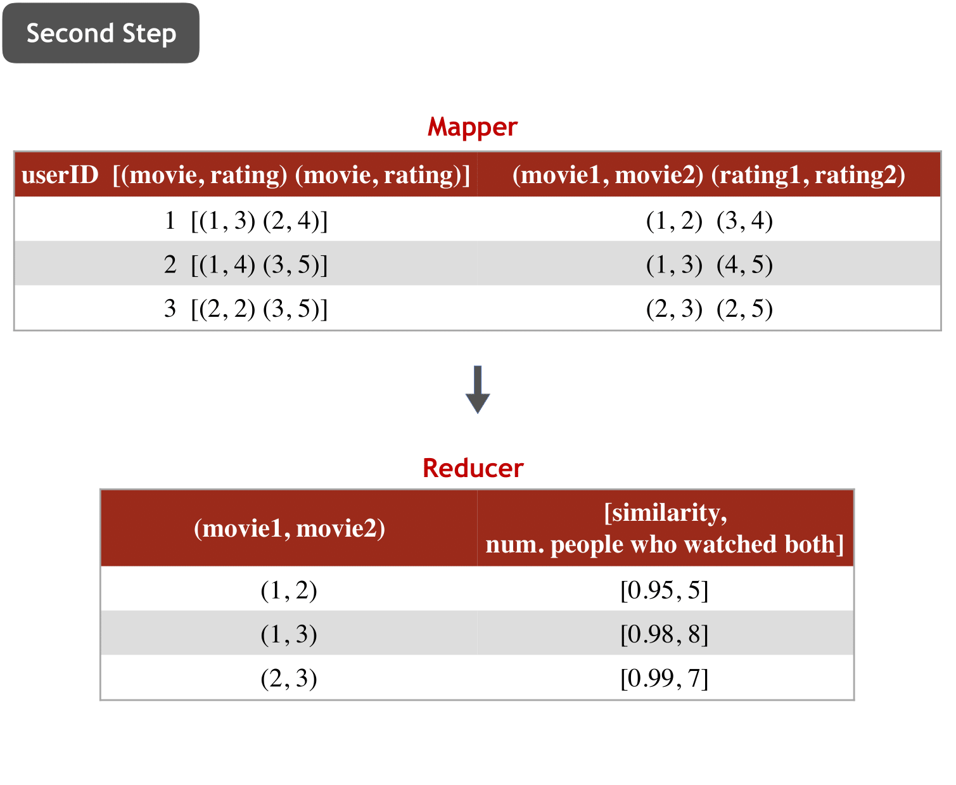
Algorithms
Item-based: 3-step MapReduce
Secondly, we want to get every pair of movies that were watched by same person and its corresponding rating pair. We will use a mapper to get key-value pair looks like: (movie1, movie2) - (rating1, rating2). Then we want to measure similarities between each movie pair. We use a reducer to compute rating-based similarity between each movie pair and get its similarity scores (movie1, movie2) – (similarity scores, number of person who watched both).
Haowen Shang (MACSS, University of Chicago)
Notes:
‹#›

Slide 8
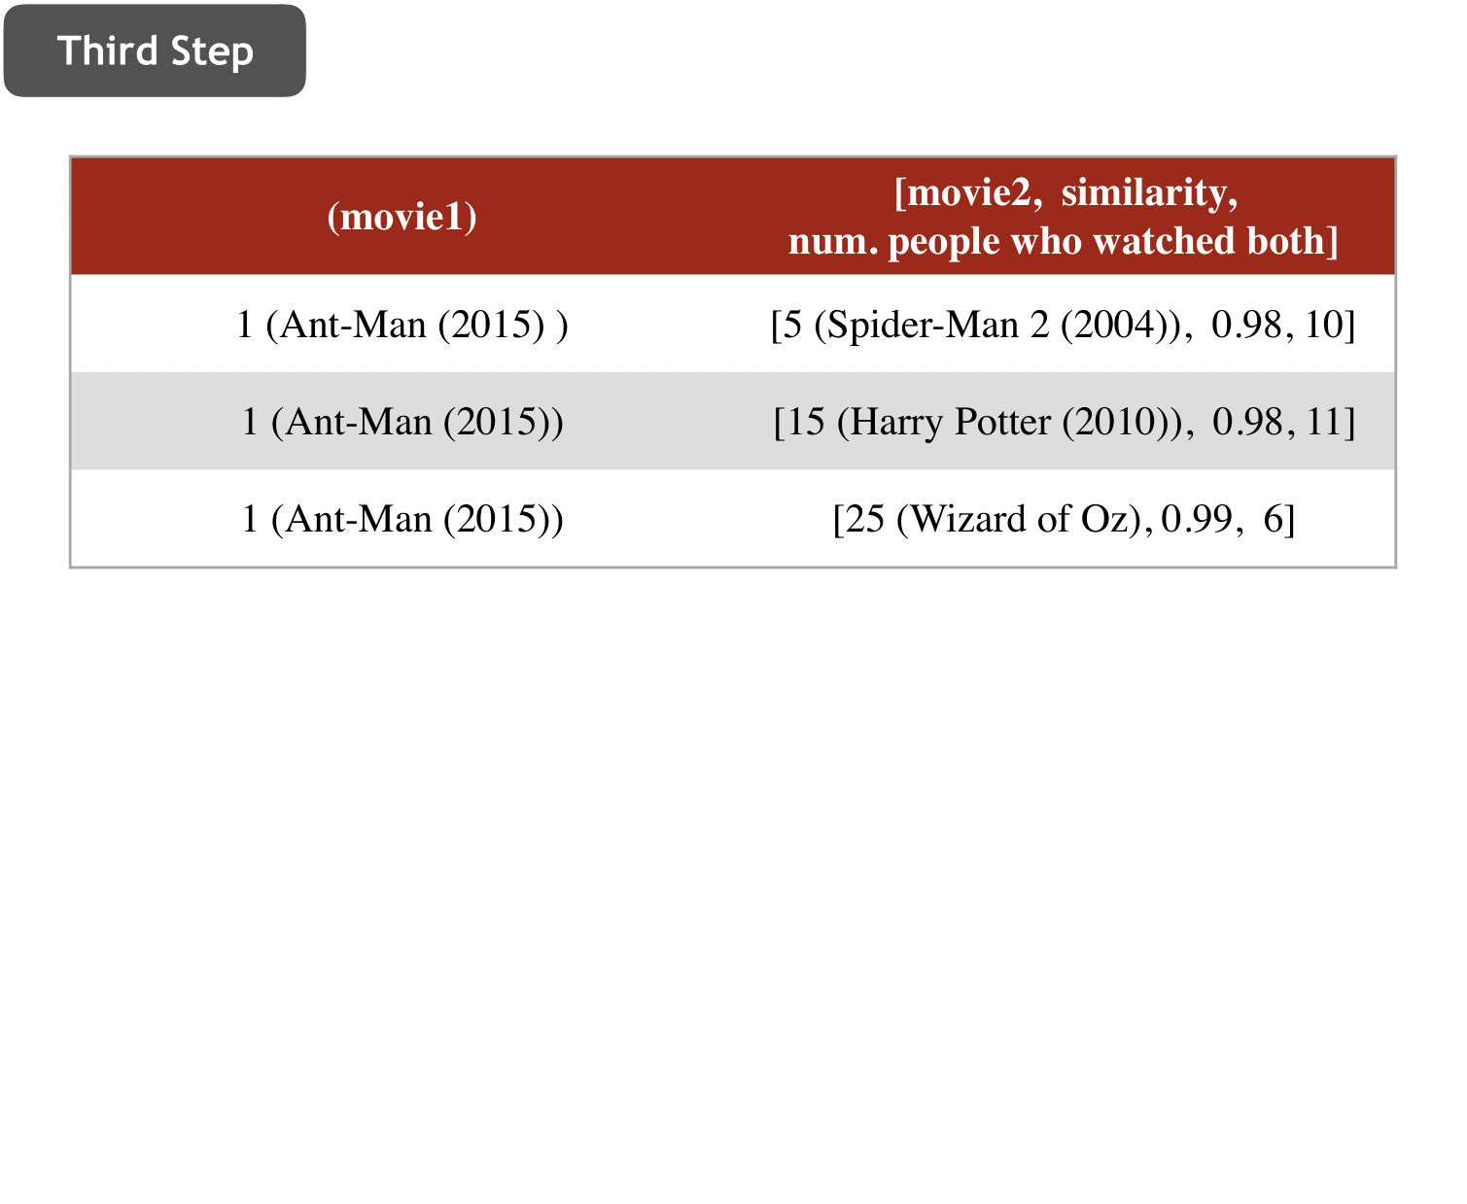
Algorithms
Item-based: 3-step MapReduce
Thirdly, we will get the output with movies followed by a list of similar movies.
Output Format
"Movie" ["Similar_movie", "Sinilarity_score (from 0 to 1)", "Number of people who watched both"]
Similarity Scores
Cosine Similarity: Cosine Similarity Score is defined as cosine of angle between two rating vectors. If the score is 0, the movie pair is not similar. If the value of score is 1, it indicates both the movies are similar. Closer the movies, smaller will be the angle and larger the cosine.
Haowen Shang (MACSS, University of Chicago)
Notes:
‹#›

Slide 9
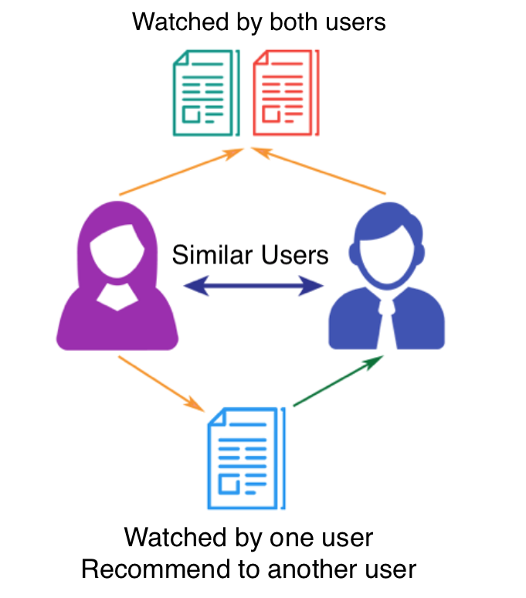
Algorithms
User-based: Overview
Calculate Similarity
K Nearest Neighbor
Final prediction for all the users on all unwatched movies
Prediction score for one user on one unwatched movie
Tianxin Zheng (MACSS, University of Chicago)
Notes:
‹#›

Slide 10

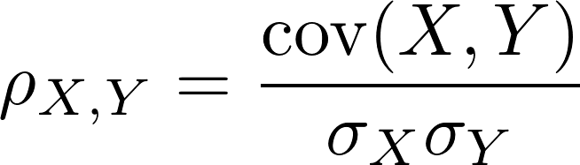
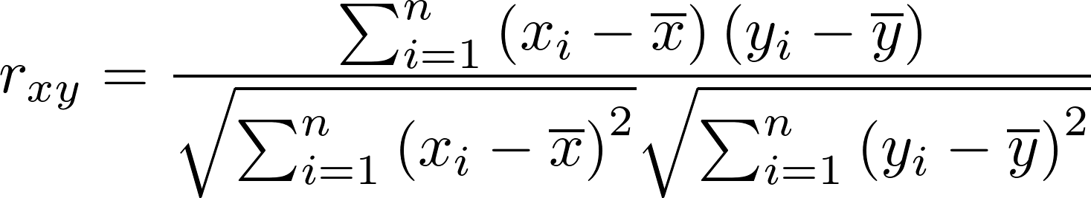
Algorithms
User-based: Pearson Correlation
We first calculated the similarity between two users using Pearson similarity.
Here we measured pearson similarity by the two users’ ratings for the common movies they watched. Specifically, when calculating the rating average for each user, we included the user’s ratings for all the movies, not just the intersection of the two users’ ratings. However, when computing summation, we only used movies that both users had rated.
Tianxin Zheng (MACSS, University of Chicago)
Notes:
‹#›

Slide 11
Algorithms
User-based: K Nearest Neighbor
After obtaining the similarity score between one user and all the other users calculated using Pearson similarity, we got the top K users who were most similar to this user using sorting. If two users had the same similarity score, we used the user-id as a tie breaker.
Tianxin Zheng (MACSS, University of Chicago)
Notes:
‹#›

Slide 12
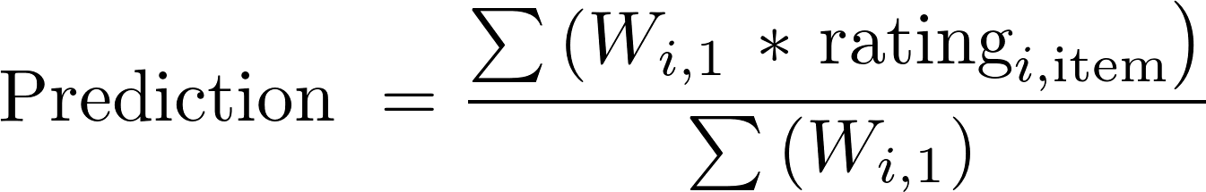
Algorithms
User-based: Prediction for One User on One Movie
We then made prediction for one specific movie for one user by calculating a simple weighted average of the ratings provided by the k most similar users. Specifically, we only included users who had rated this movie. We used the above formula, where Wi,1 is the similarity of user i with user1 from the k most similar users.
Tianxin Zheng (MACSS, University of Chicago)
Notes:
‹#›

Slide 13
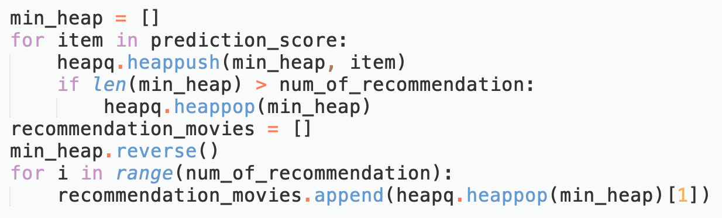
Algorithms
User-based: Final Prediction for all the Users on all the Unwatched Movies
Finally, We applied this prediction algorithm to all the users and all the movies the users haven’t watched in the dataset, and then got top k movies for recommendation based on the prediction ratings using priority queue.
Tianxin Zheng (MACSS, University of Chicago)
Notes:
‹#›

Slide 14

Challenges
Not very familiar with Google Cloud
Put code in one py.file
Item-based algorithm
Incorporate different steps in MapReduce
Implement mrjob.conf
User-based algorithm
Use priority queue instead of sorting
Filter out for efficiency in algorithm
Ruixi Li (MACSS, University of Chicago)
Notes:
‹#›

Slide 15
Results: Item-Based Approach
Run Item-based Algorithm
Yield Similarity between Movie Pairs s_{ij}
For a user watched movie 5, 15, 25:
Calculate Weighted Similarity as Predicted Rating for unwatched movie
Recommend Movie with Highest WS!
Boyang Qu (MACSS, University of Chicago)

Slide 16
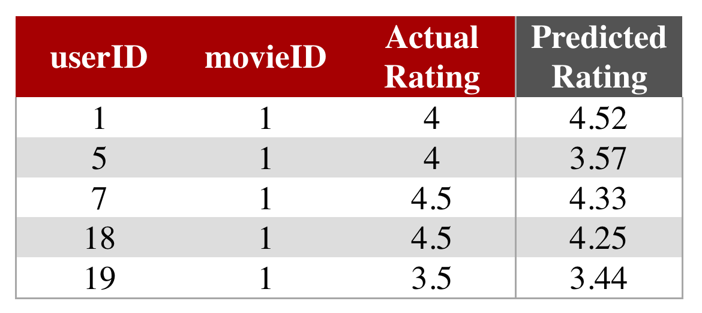
Results: User-Based Approach
userID
movieID
K Nearest Neighbors
We calculated the predicted rating for users with their watched movie (K = 10), and the prediction score is SIMILAR to their actual rating score.
Boyang Qu (MACSS, University of Chicago)

Slide 17
Results: Accuracy
Item-Based Recommendation
User-Based Recommendation
Split Dataset into Training and Testing dataset by User
Split Dataset into Training and Testing dataset: treat ¼ of rated movie of each user as unwatched
Testing Dataset: for each user, randomly select half of the rated movie as unwatched for testing
Calculate MSE for Predicted vs Actual Rating
MSE = 0.048
Accuracy = 0.952
Expect to be similarly accurate
Boyang Qu (MACSS, University of Chicago)

Slide 18
Thank you!
Notes:
‹#›

